Slide 1
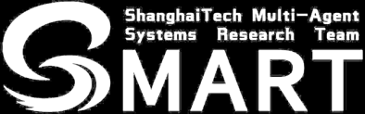
A Redistribution Framework for Diffusion Auctions
Sizhe Gu, Yao Zhang, Yida Zhao, Dengji Zhao
Shanghaitech University
Notes:
Good afternoon, everyone. Im Sizhe Gu from shanghaitech university.
it is a great honour to share our work with you.
It is about A Redistribution Framework for Diffusion Auction,

Slide 2
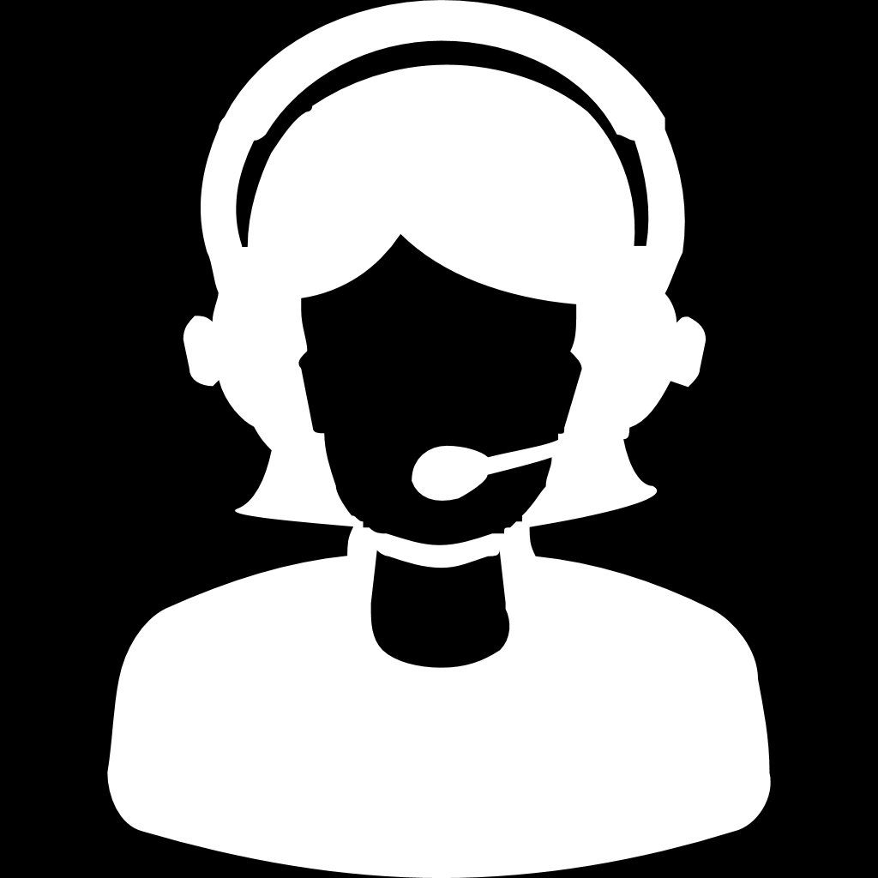


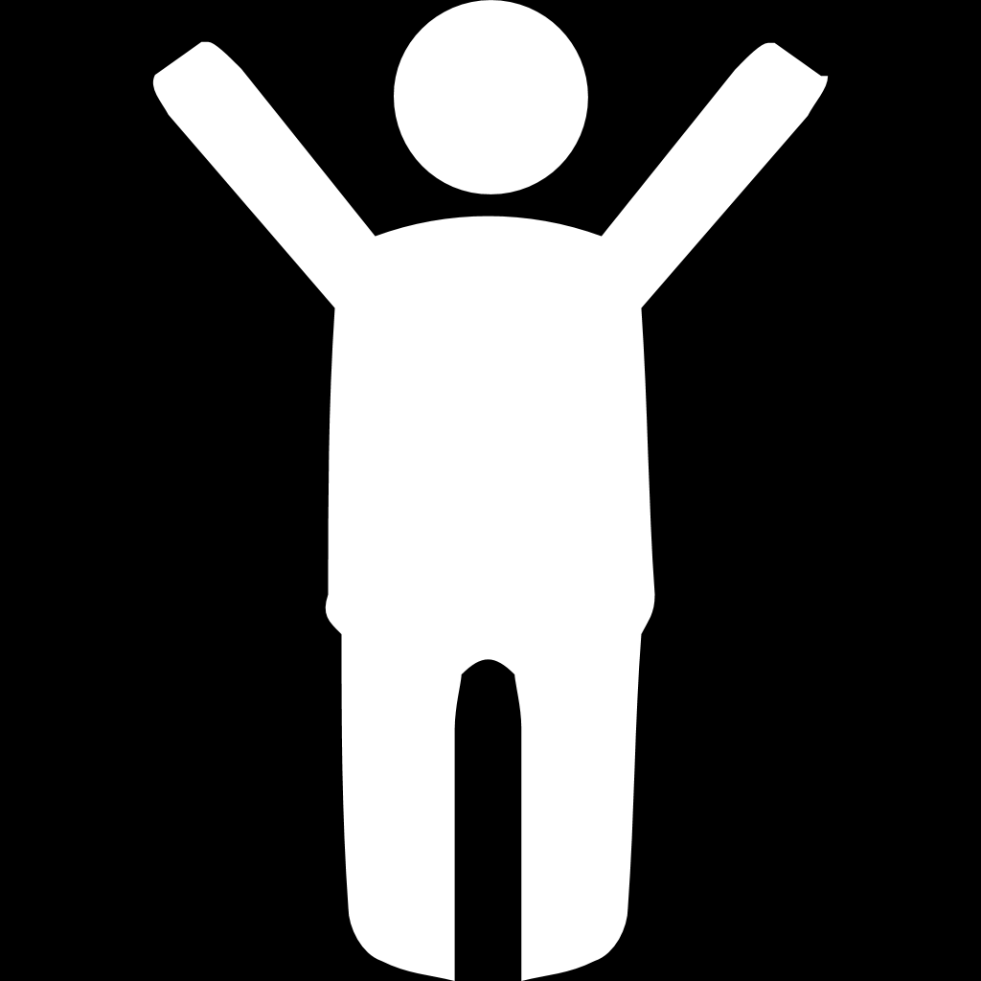
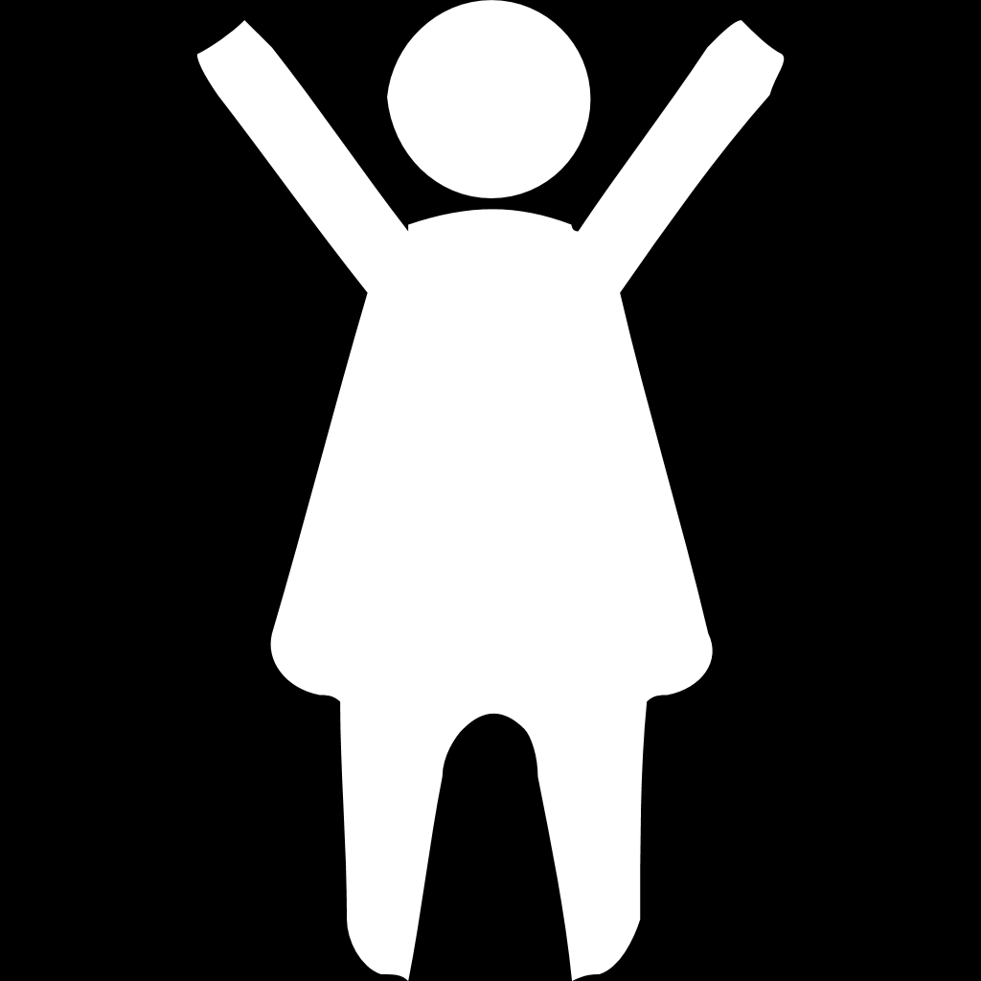

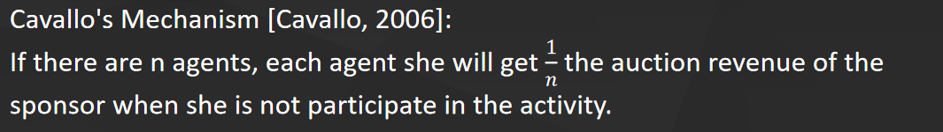
Background
Redistribution Mechanism
6
2
5
9
9
6
6
Notes:
However, considering There are some non-profit organizations, the organizers do not need to gain any profit.
Therefore, on the basis of the auction, the organizer will return the auction revenue back to the agents.
Not only it meets the needs of the new scene, but also ensures high social welfare.
This is the so-called redistribution problem, and these issues have been fully discussed and solved in the traditional setting.
Cavallo's mechanism was the first to solve this problem in 2006. When calculating the redistribution value, each agent will get 1 over n of the baseline value,.
and each agent's baseline value is the auction revenue after removing certain agent herself.

Slide 3
Background
→ Auction
Resource Allocation
2
5
9
9
6
6
Second price auction
Notes:
To begin with, let’s talk about the background of our work.
In the traditional single-item resource allocation scenario, each agent has a valuation to the item.
So what we need to do is to aollcate the item to the agent with the high valuation, so as to achieve high social welfare.
A common way to achieve this goal is to hold an auction. Under the classic second-price auction, item will be sold to the agent who bid 9, and then she will pay 6.
6 is the second highest price. The benefit of this auction mechanism is that agents will honestly report their valuation to the item.

Slide 4
Background
Social Networks
Under the traditional setting, there is an upper limit of the social welfare.
Using social networks to invite new agents via their social connections to join in.
Existing Soical network
diffusion auction mechanisms：
a. Incentive Diffusion Mechanism
(IDM) [Li et.al. 2017]
b. Fair Diffusion Mechanism
(FDM) [Zhang et.al. 2020]
c. Threshold Neighbourhood Mechanism
(TNM) [Li et.al. 2022]
...
5
9
2
6
4
18
10
16
Notes:
So, the above is the study of resource allocation problem in the traditional setting.
However, there is a static social welfare upper bound.
Because the organizer can only convene a fixed set of agents that they can contact.
In recent years, researchers have begun to design mechanisms on social networks.
They want to motivate agents to invite new agents to join through their social connections
In the figure below, the sponsor can only contact four agents in the traditional setting, through the social connections of the four agents, sponsors can reach more agents.
New agents can invite more agents.
Then, in resource allocation, as the number of agents increases, we are more likely to allocate item to agent who has a higher valuation to the item, thus we can improve social welfare.
This is the significance of introducing social networks into this problem.
And there are many existing soical network diffusion auction mechanisms like IDM FDM TNM and so on.

Slide 5
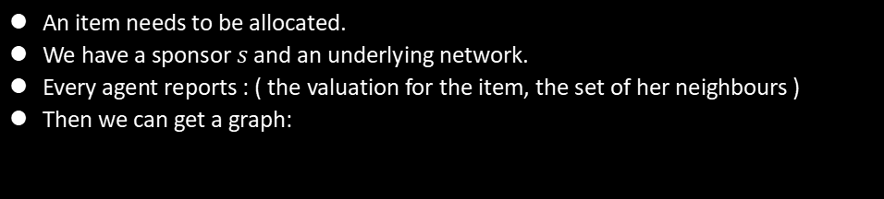
Model
Definitions
An item needs to be allocated.
We have a sponsor $s$and an underlying network.
Every agent reports : ( the valuation for the item, the set of her neighbours )
Then we can get a graph:
$$s$$
$$A$$
5
B
7
C
2
$$D$$
6
$$E$$
10
F
8
G
3
H
11
I
9
J
14
K
13
Notes:
Then, I will show the model briefly.
First, only one item in the scene needs to be allocated.
The item is assigned by sponsor s.
And there is a social network structure that includes this sponsor
We then ask each agent to report two pieces of information about herself, one is about her own valuation to the item and the other is the set of her neighbors in the social network
According to the participants' reports, we can get a graph
In this example, we can see that the letters from A to K represent 11 agents who actually joined, and the number in the circle is their valuation to the item.

Slide 6
Model
$$s$$
$$A$$
5
B
7
C
2
$$D$$
6
$$E$$
10
F
8
G
3
H
11
I
9
J
14
K
13
The item will allocate to an agent through an input diffusion auction mechanism, and the sponsor will get the revenue.
Then the sponsor will redistribute almost all of the revenue to the agents.
Notes:
So what do we need,
first of all we need to distribute this item to a agent through an input social network diffusion auction mechanism
The sponsors will get revenue from the auction
Then the sponsor will then return almost all of the revenue to the agents, which is what our framework does.

Slide 7
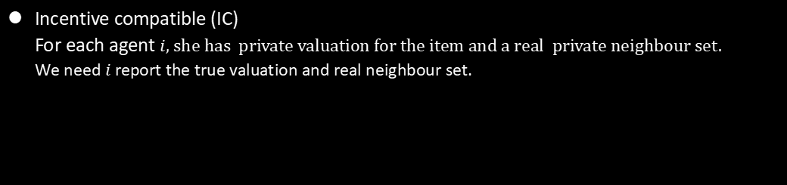
Model
Properties
Incentive compatible (IC)
For each agent $i$, she has private valuation for the item and a real private neighbour set.
We need $i$ report the true valuation and real neighbour set.
So we just have to make sure that when she reports truthfully, her utility is higher than the result
when she misreports.
Individually rational (IR)
We should ensure that an agent should not suffer a loss if she reports her true valuation on
the item
Notes:
So, let's look at some of the important properties that this framework needs to satisfy
Incentive compatible askes each agent to truthfully report their private information, including valuation and neighborhood sets.
And Individually rational guarantees that each agent will not suffur loss when they truthfully report the valuation, which also guarantees that they will participate in the activity.

Slide 8
Model
Properties
Non-deficit (ND)
The sum of the payment transfers should be non-negative for the sponsor;
otherwise, she will pay a deficit.
Asymptotically budget-balanced (ABB)
We want the instance of the framework to redistribute the revenue back to agents as much as
possible, i.e., the sum of the payment transfers should be 0. However, it is hard to satisfy.
So we consider a asymptoical propertiy that when the number of the agents goes to infinity,
the payment transfers should be close to 0.
Notes:
The property of non-deficit protects the interests of the sponsor. In the resource allocation activities,
It is unreasonable to use too much money to invite more people to attend
Finally, we hope that the redistribution mechanism can distribute all auction revenue back to the agents,
However, this seems difficult to achieve, so we have considered the property of asymptotic budget balance,
When the number of people in social networks approaches infinity, the remaining share redistributed is also infinitely close to zero,
Of course, this can only be met under certain assumptions

Slide 9
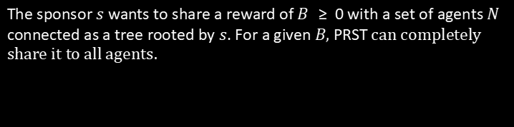
Proportional Reward Sharing in a Tree (PRST)
The sponsor $s$ wants to share a reward of 𝐵 ≥ 0 with a set of agents 𝑁 connected as a tree rooted by $s$. For a given $B,$ PRST can completely share it to all agents.
Notes:
I will go straight to the two parts of our framework. The first part is PRST. If a sponsor wants to share a fixed budget with a set of agents connected as a tree rooted by $s$,
PRST can completely share it to all agents and it can ensure that the whole process is IC.

Slide 10
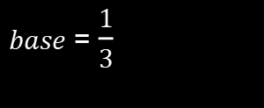
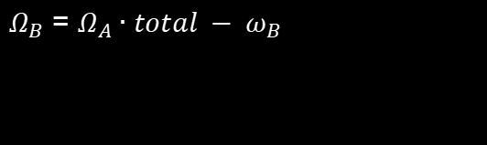






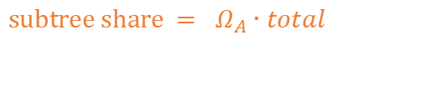

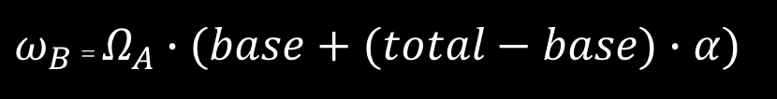

PRST
A remains
share${ Ω}_{A}$
$$s$$
$base$ = $\frac{1}{3}$
$total$ = $\frac{3}{5}$
$base$ = $\frac{1}{3}$
$total$ = $\frac{3}{5}$
$$A$$
subtree share $= Ω_{A}∙total$
$$B$$
$ω_{B}$ = $Ω_{A}∙(base+(total−base)∙α)$
$Ω_{B}$ = $Ω_{A}∙total − ω_{B}$
$$( 0≤α≤1 )$$
Notes:
Lets show how PRST works by an example.
In this tree, agent A remains a share Big Omega A to all her 5 children.
For agent B, we wonder how much share she's gonna get.
First, see the subtree rooted by B, the whole share of the all agents in this subtree is the total three fifth.
Then lets only focus on B. If B not invite her children, she will still get a base as the basic share.
And B will get a part of the total as the reward for her invitation. Then B can get her share proportion :the little omega B.
B will remian big omega B like A to her children. By this method, we can share all reward from s.

Slide 11
Network-based Redistribution Mechanism Framework
(NRMF)
Input diffusion auction mechansim
Output redistribution mechansim
incentive
compatibility(IC)
incentive
compatibility(IC)
non-deficit (ND)
individual
rationality(IR)
individual
rationality(IR)
non-deficit (ND)
revenue monotonic
Asymptotically budget-balanced (ABB)
revenue invariant + IR
Notes:
And more important is the NRMF Network-based Redistribution Mechanism Framework.
In this part We can get an output redistribution mechanism by inputing a diffusion auction mechanism to NRMF.
If the input mechanism is IC, the output redistribution mechansim is also IC.
And if the input is ND and IR, the output is IR.
If the input satisfies revenue monotonic, The output is ND.
For ABB, the input mechanism should be revenue invariant and IR.

Slide 12









NRMF step1
$$s$$
$α$ = 0.8
$$s$$
$$s$$
$$A$$
5
B
7
C
2
$$A$$
$$A$$
F
5
F
8
7
2
C
0.242
0.116
0.091
0.116
C
B
$$D$$
6
$$E$$
10
F
8
G
3
B
H
H
0.117
0.061
0.061
0.065
0.065
11
6
10
9
3
H
11
I
9
$$D$$
$$E$$
I
G
$$D$$
$$E$$
I
G
K
J
K
J
0.032
0.032
14
13
J
14
K
13
T (𝜃 ′)
𝐺 (𝜃 ′)
Generate a diffusion critical tree 𝑇 (𝜃′) from 𝐺 (𝜃′)
Run PRST on T (𝜃 ′)
Notes:
We also show how NFRM works. First, we generate a diffusion critical tree.
The critical tree reflects the relationship of invitation.
For example, H will connected to A but not D or E in the critial tree。
And run PRST on tree. Then we can get all agents’ share proportion little omega.

Slide 13

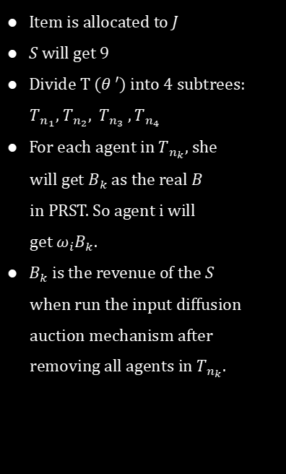



NRMF step2
Item is allocated to $J$
$S$ will get 9
Divide T (𝜃 ′) into 4 subtrees:
$T_{n_{1}}$, $T_{n_{2}}{, T}_{n_{3}} ,T_{n_{4}}$
For each agent in $T_{n_{k}}$, she
will get $B_{k}$ as the real $B$
in PRST. So agent i will
get $ω_{i}B_{k}.$
$B_{k}$ is the revenue of the $S$
when run the input diffusion
auction mechanism after
removing all agents in $T_{n_{k}}.$
$$s$$
9
$$s$$
7
B
7
2
5
B
7
C
2
$$A$$
5
C
$$A$$
6
10
8
G
3
10
$$D$$
$$E$$
10
F
8
G
3
$$D$$
6
$$E$$
F
H
11
H
I
9
11
I
9
13
$$T_{n_{2}}$$
$${ T}_{n_{3}}$$
$$T_{n_{4}}$$
14
K
13
14
J
K
13
J
$${ T}_{n_{1}}$$
Run diffusion auction mechanism IDM in 𝐺 (𝜃 ′)
Notes:
Then we run auction mechanism on the origin graph.
In the examplem, the item is allocated to J. The arrows means the payment transfers of agents. s get 9 as the budget.
Now we divide the critical tree into subtrees. they are all rooted by the neighbours of the sponsors in the critial tree.
For each agent in kth subtree, she will get $B_{k}$ as the real $budget B$ in PRST. So agent i will get $ω_{i}B_{k}.$ as the final revenue of redistribution
$B_{k}$ is the revenue of the $S$ when run the input diffusion auction mechanism after removing all agents in kth subtree.
For example, B1 is the reslut of IDM after removing all agents in Tn1 in the origin graph.

Slide 14

NRMF step2
${Get B}_{1}=7$
E.g. $u_{J}$ = 14 - 13 + 0.032 $×$ 7 = 1.224
$$s$$
7
$$A$$
5
B
7
C
2
$α$ = 0.8
$$s$$
$$D$$
6
$$E$$
10
F
8
G
3
$$A$$
0.242
F
0.116
0.091
0.116
C
H
11
I
9
B
H
0.117
0.061
0.061
0.065
0.065
J
14
K
13
$$D$$
$$E$$
I
G
J
0.032
K
0.032
Run IDM in 𝐺 (𝜃 ′)
Run PRST on T (𝜃 ′)
Notes:
We can get B1 equal 7 and we can get agent’s utility.

Slide 15





NRMF step2
$α$ = 0.8
$$s$$
$$A$$
2.694
F
0.812
0.819
1.044
C
B
H
3.819
0.427
0.427
0.455
0.585
$$D$$
$$E$$
I
G
J
1.224
K
0.224
final utilities
remain = 9 - 7.52 = 1.48
Notes:
Finally we can get the utilities of all agents,.
You can see at the end of the mechanics, there's a little left share.

Slide 16
Summary
Framework can satisfies some good properties.
The framework is the general solution under traditional setting and soical network.
PRST can be directly applied to social network incentive distribution problem.
Future work
Extending the framework to multi-item setting
A more in-depth discussion about the characterization of asymptotically budget-balanced (ABB)
Finding an efficient blocking method without affecting the IC in NRMF
Notes:
In general, we design a redistribution framework for redistribution in social networks.
we can input any social network difuusion auction mechanism and the framework will output a redistribution mechanism. it can guarantees many important properties like IC IR ND AND ABB under some situations
The framework is the general solution under traditional setting and soical network.
In addition, PRST, part of the mechanism of NRMF in this paper, can be directly applied to another problem in the social network scenario.
It's called the social network incentive distribution problem, and it achieves the same good nature.
Due to the time constarints, I just talk briefly about it. If there is any confusion,we can dicuss detailedly later about it. And our poster number is 9.

Slide 17
Thank you for your
patient listening!
Poster #9

